Slide 1
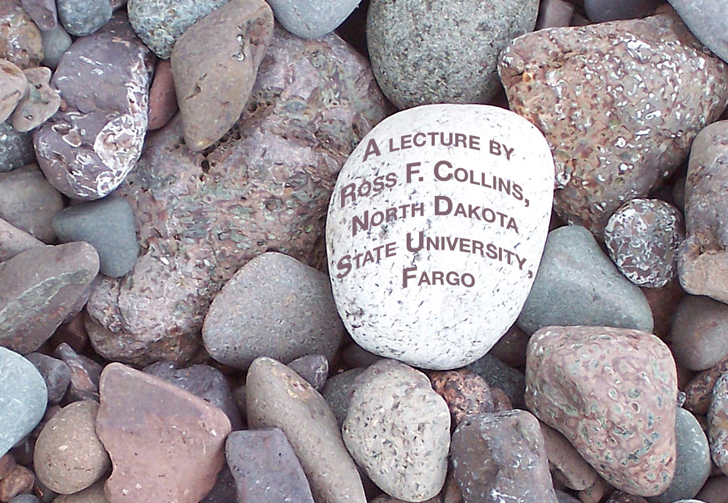
Sports
and mass media photography

Slide 2
Sports variety
Sports photographers face a wide variety of challenges.
Every sport is different, and requires specialized knowledge to get the best pictures.
Most sports photographers regularly photograph the “big three”: football, basketball and baseball.

Slide 3
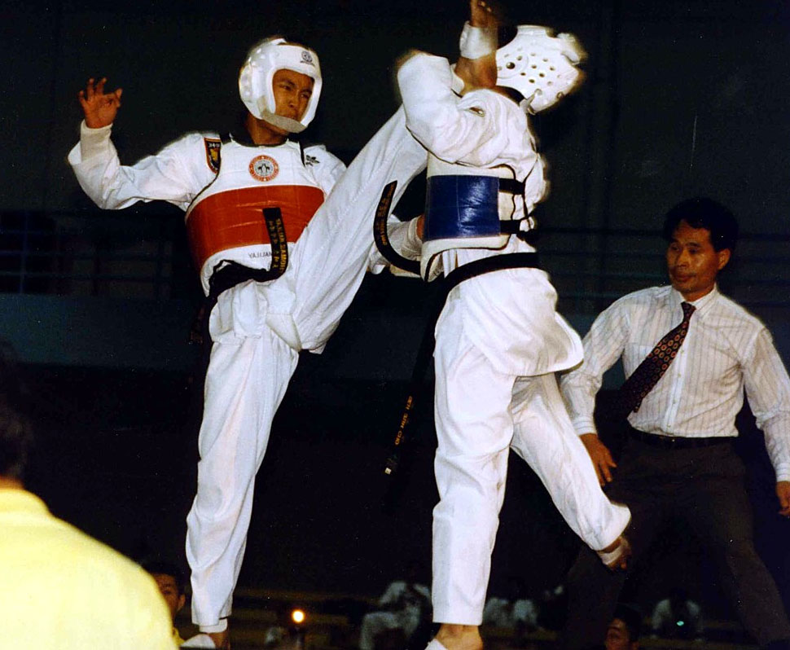
Sports possibilities
But sports also includes the “minor” sports such as tennis, track and volleyball.
And under the sports definition may also be golf, martial arts, wrestling, hang gliding, water skiing, hot air ballooning... the list seems endless.

Slide 4
Sports photo skills
What you need to take good sports photos:
Good timing;
Quick reflexes;
Knowledge of the sport.

Slide 5
High school
It’s usually easiest to practice sports photography at the high-school level.
It’s less formal, so you can move around more.
It’s easier to get press passes so you can stand on the sidelines closer to the action.
You’ll face fewer rules and limits.

Slide 6
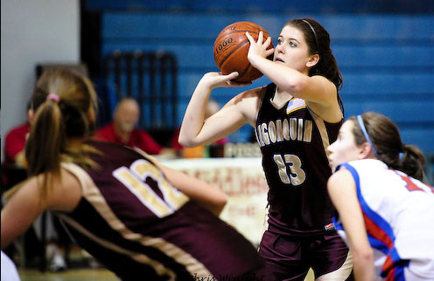
Basic sport shots
Most sports photojournalism falls into two categories:
Action.
Feature.

Slide 7
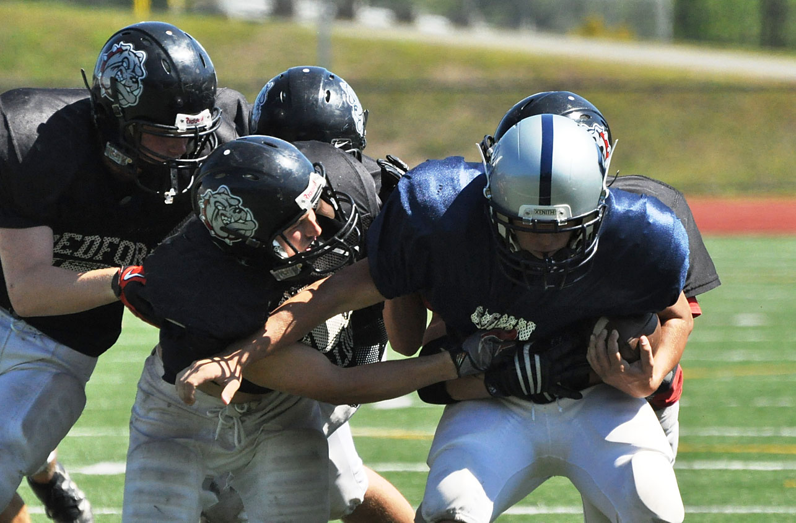
Action photos
Action sports photos are most common. Obviously, these are photos of people playing the sport.
In these shots you’re looking for the significant movement, the key play, the key players.
Great images are all right, but what sports editors really want is a key player making a key play. And that’s not so easy to get.

Slide 8
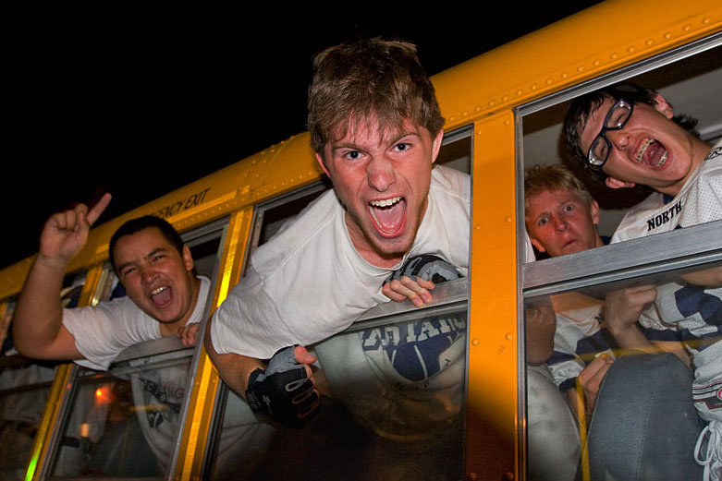
Feature photos
Sports features emphasize the environment, the ambience.
They include warm-up pictures, victory/defeat pictures, fans and coaches. Most sports photographers try to hang around a little while after the game, if possible, to capture these.

Slide 9
Photo positioning
Presuming you know the sport, you’ll know where to position yourself for the key play, and which player to focus on.
In sports photography knowledge is usually more important than sophisticated equipment.
Lots of good sports photos can be taken with an average DSLR. Of course, some can’t, either.

Slide 10
Equipment
Most sports photographers emphasize that at the least you will need a long telephoto or zoom lens.
Long lenses bring the action closer to you, and better isolate it from a distracting background.
Action photos in such field sports as football and baseball are nearly impossible without a telephoto lens reaching at least to about 200mm (film equivalent).

Slide 11
Equipment
Many sports photographers choose a telephoto or zoom reaching to about 300 mm for field sports.
Of course, a lens of this length is heavy and hard to hold steady. Minimum shutter speed is about 500.
Some of these lenses are stabilized. You’ll also see photographers commonly shooting with a monopod for sharper photos.

Slide 12
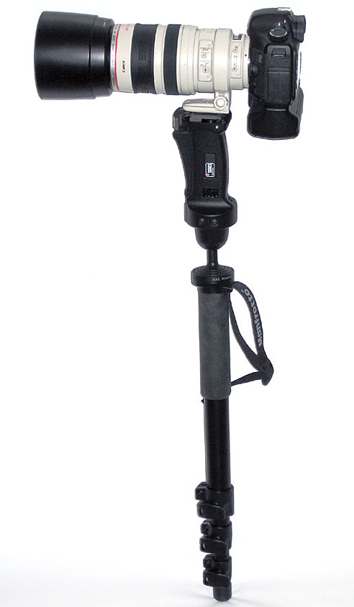
Monopods
This is a typical setup for field sports photography: long lens (possibly stabilized), monopod for added stability.
We use a monopod instead of a tripod because its easier to move around fast. It does sacrifice some stability.

Slide 13
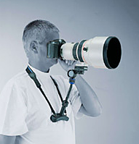
Chest pods
When I shot field sports, I actually preferred something photojournalists call a chest pod. It adds quite a bit of stability, but is much less clumsy. Videographers somtimes favor this, as stability is critical for videos.

Slide 14
Burst mode
Many sports photographers use “burst mode,” that is, on digital cameras shooting several frames quickly, as a way to capture peak action.
While this does improve the possibility of getting a key shot, keep in mind that the shutter is still closed most of the time.
There’s no substitute for knowing the sport, anticipating the action, and with timing and good reflexes squeezing the shutter at just the right moment.

Slide 15
A general approach
Here’s the general procedure when planning to photograph a sporting event.
Unless you know the gym or field, check out the lighting ahead of time. Look for good places to stand. You may have to arrive early to grab the best locations before another photographer gets there.
Consider adding artificial lighting, if necessary. Flash-on-camera is last resort, and will seldom produce really good sports pictures.

Slide 16
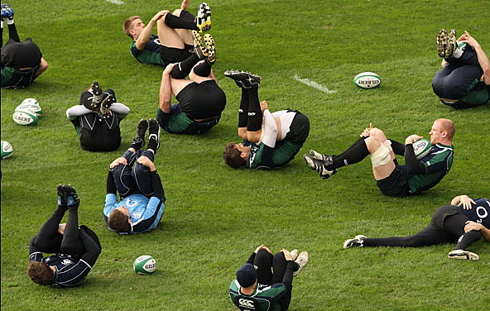
A general approach
3. Get shots of the athletes warming up, particularly the most important ones. That way, if you miss that athlete making a key play, you still have a shot the editor can use.

Slide 17
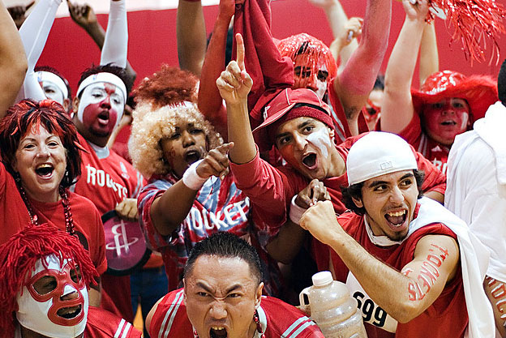
A general approach
4. Get a program so you can identify players by number. Most sports editors want players identified.
5. Watch for fan reactions. Often it’s a fleeting facial expression that makes the great sports shot.

Slide 18
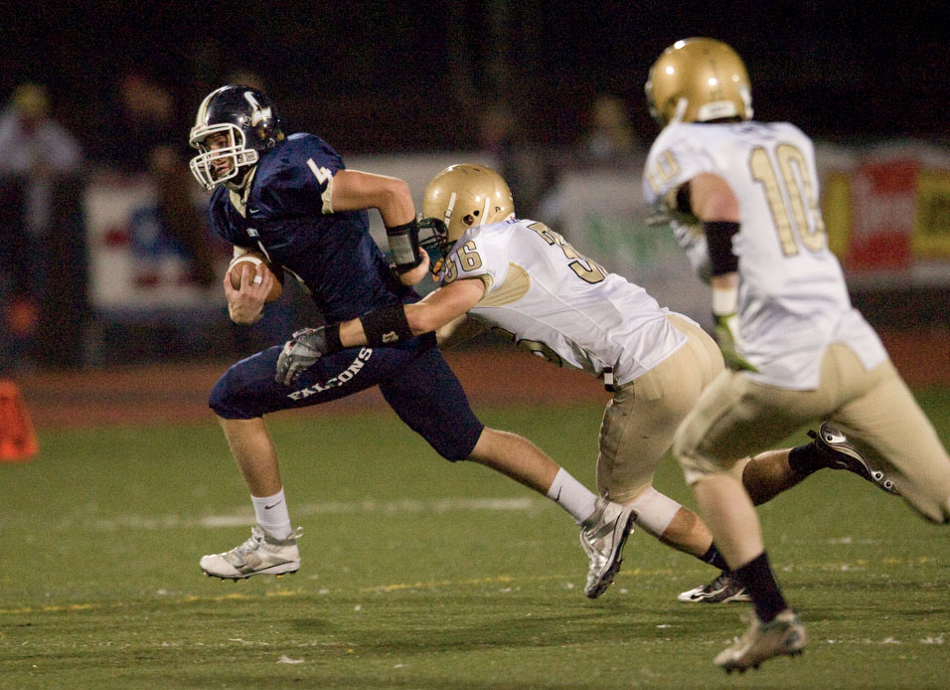
A general approach
7. Get the ball in the photo. Usually that’s the center of interest.

Slide 19
A general approach
7. Take notes for photos you think will be good. Note the players’ names, what was happening, so you can write good cutlines later.
8. Accept that a lot of your photos will be fuzzy or poorly composed. A principle of sports photography is that you have to take a lot of bad images for a few good ones. But the photo you choose DOES have to be one thing: sharp.
How do you take sharp sports photos?

Slide 20
Sharp pictures
Use a monopod or chestpod.
Focus on an area, and wait for the action to move to that area.
Follow focus: try to let your auto-focus keep up with the action as you follow it with your camera. Spot metering may help here.

Slide 21
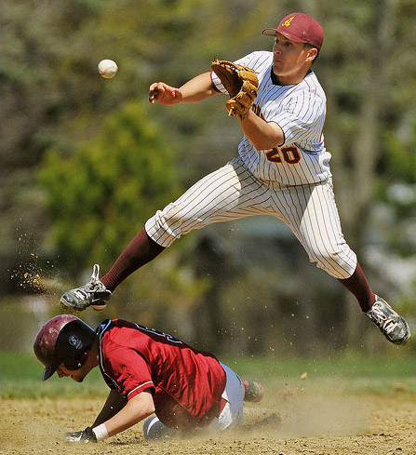
Sharp pictures
Favor a high shutter speed to stop action. Minimum will probably be 500 (1/500 sec). Keep in mind you often shoot in poorly lit areas with long, and therefore slower, lenses. You may have to compromise quality by increasing ISO.
Anticipate the moment. In some sports, such as diving, the action actually stops at the peak moment.

Slide 22
Football
If you have to stay in the stands to take action pictures, you’ll need a really long telephoto lens—500mm or more. Most good football photography comes from photographers with passes allowing them to stand on the sidelines.
Usually you can’t walk in front of the players’ benches, and you may have to crouch to avoid obstructing the view of the fans.

Slide 23
Football
Photographers often stand 10 or more yards ahead of the line of scrimmage, and wait for the action to come to them. Particularly if you don’t have a really long lens, wait for the action to come your way.
If someone is going to pass, swing to the target of the pass, to anticipate that action.
If action moves to the end zone, move to the end zone. It often gives you the best touchdown pictures.
Most football pictures are best shot horizontally.

Slide 24
Football
Football is one of the more hazardous sports to photograph. Photographers can be seriously injured standing on the sidelines. Heavy guys in full padding are often knocked out of bounds. Sometimes just where you happen to be standing.
Be ready to step back quickly when you see someone charging your way. Players have padding. You don’t.
If you are near the action, never take your attention away, even for a moment. This principle is true of all sports photography.

Slide 25
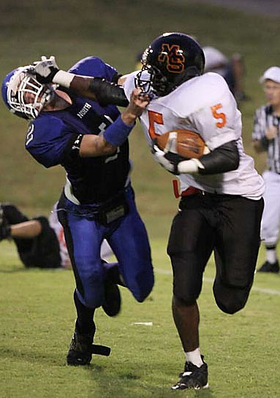
Football
Football is a contact sport, and the best pictures show that.
Avoid photos of players at the line of scrimmage.
Avoid solo players running down the field.
Avoid photos of a pile-up after the play is over.

Slide 26
Football: night
Some stadiums are too dark for action shots at night. You may have to use flash to stop the action.
Keep in mind your flash won’t be effective beyond about 25 feet.
You will have to wait for the action to come close. Pay attention and get ready to move out of the way, if necessary!

Slide 27
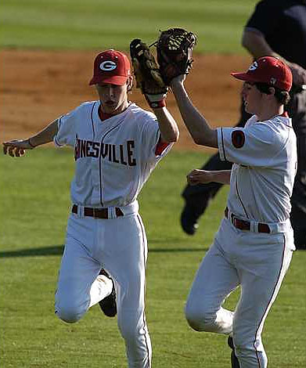
Baseball
It’s tough to shoot good baseball photos. The field is large, the players are spread out, and there’s not a lot of action.
You have to wait for the occasional flurry of action, and anticipate where it might take place.

Slide 28
Baseball
Most common shooting locations are at the first and third baselines. A lot of action ends at first base. You can also see emotions of second baseman.
Outfield is impossible without a really long telephoto.
Most action in baseball happens at the bases. Photographers generally set up a tripod and wait. They don’t move around much.

Slide 29
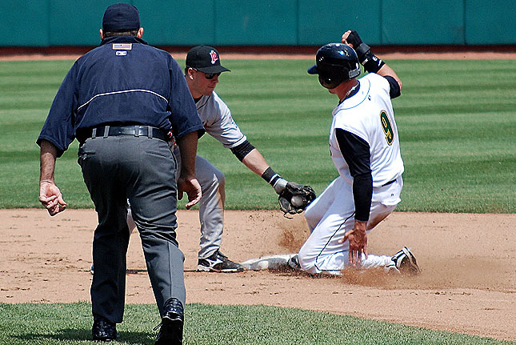
baseball
Many photographers try to avoid photos of the second-base slide. This is the most common baseball action photo.
Okay, shoot it if it happens, but try to find something else.

Slide 30
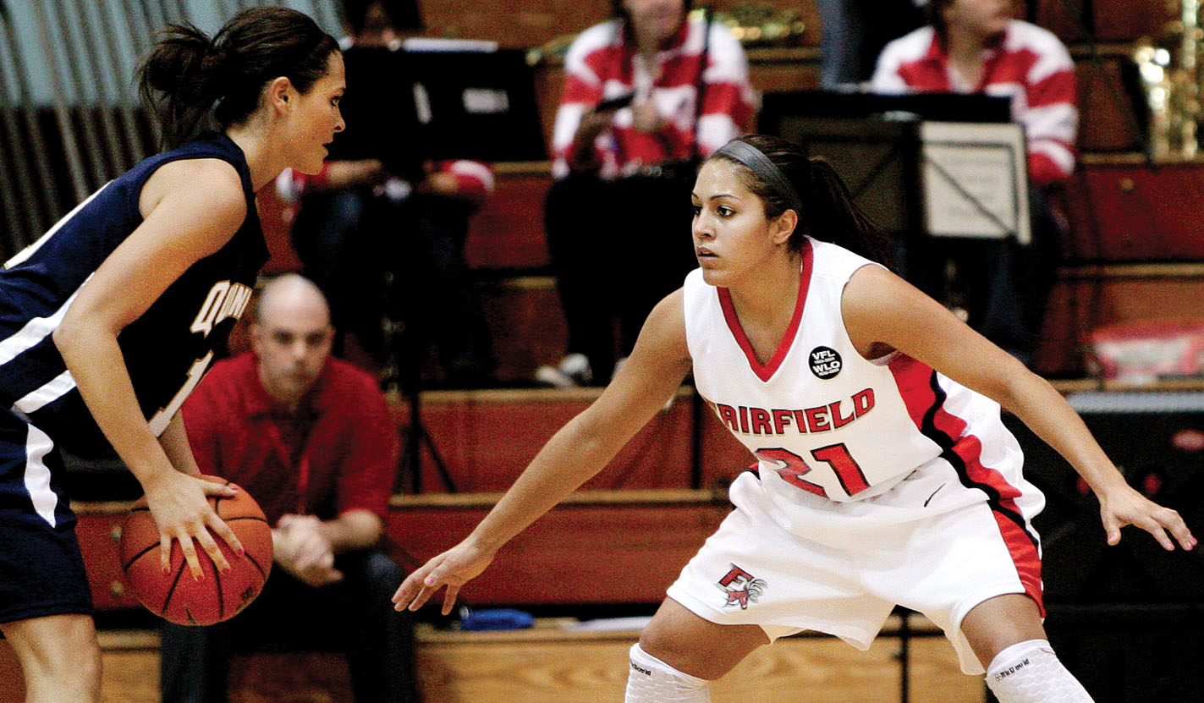
Basketball
Lighting is the biggest problem in basketball. It’s always inside, and most gym lighting is not designed for photography. Flash is last resort, however.
You’ll still need fast shutter speeds, and high ISOs. But you do have one benefit over football: you don’t need long telephotos.

Slide 31
basketball
Don’t try to move around the court to keep up with the action. It moves too fast.
Look for key players. Focus on a zone, and wait for the player to move into it.
Most common shooting location is at one end of the court, to one side of the basket.
The court is relatively small, so a standard zoom lens or “kit” lens is usually adequate.

Slide 32
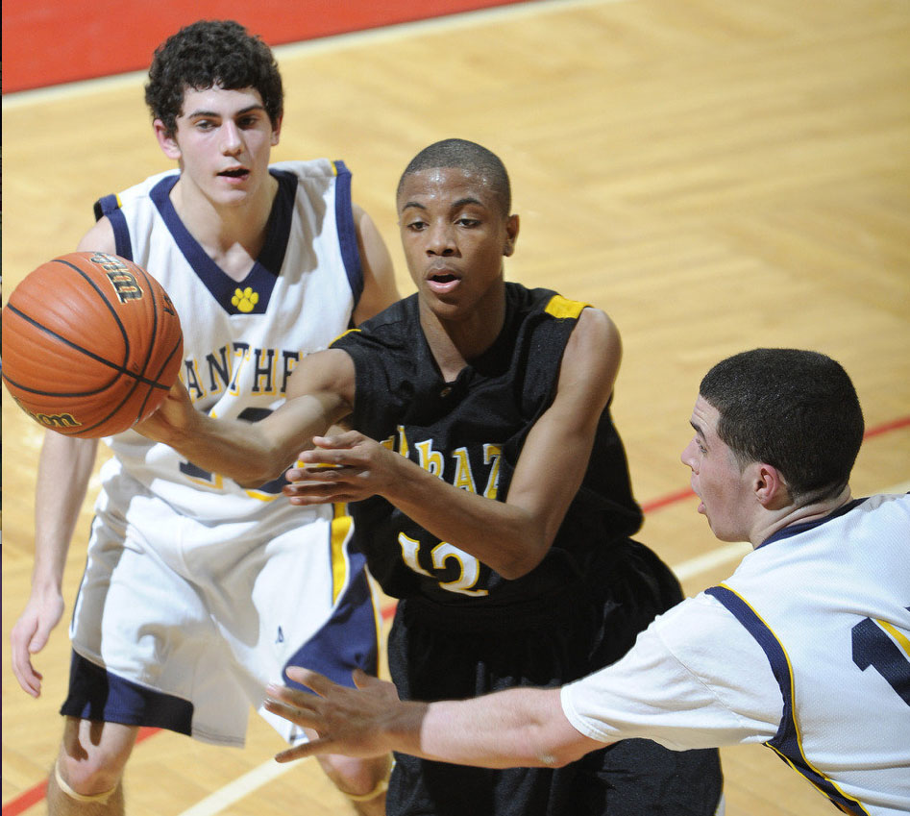
Basketball
Concentrate on floor action, interesting expressions. Make sure the ball is in the picture.
Try a few shots from the bleachers, for an interesting high angle.

Slide 33
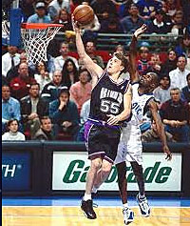
basketball
The top basketball cliché is a player making a lay-up or a “slam-dunk.” Sports photographers call this the armpit shot. Try to avoid it.
Also try to avoid shots of arms flying in the air, as in a block. Also a basketball cliché.

Slide 34
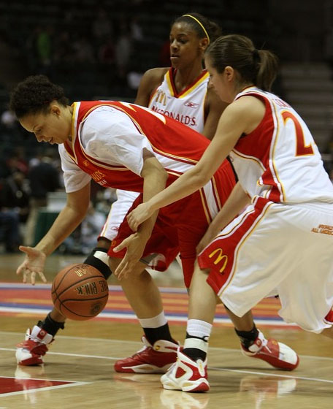
Basketball
Most basketball action pictures happen around the basket.
Basketball action pictures are generally shot in vertical format.

Slide 35
Best practices
Every sport has its own peculiarities, and sports photographers need to be prepared for those. But here are some general principles.
Get in close, perhaps with a telephoto/zoom lens.
Use fast shutter speeds.
Zone focus, and/or use a monopod/chest pod.
Avoid cliché shots.

Slide 36
Best practices
Get the ball in the picture.
Look for the news: key player making key plays.
Shoot lots of pictures, and expect most of them not to turn out.
Try panning.
Anticipate and react quickly.
Never turn your back on the action.

Slide 37
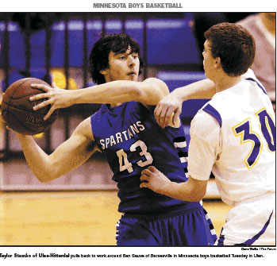
Professional work
Let’s consider some recent sports photography. Basketball:

Slide 38
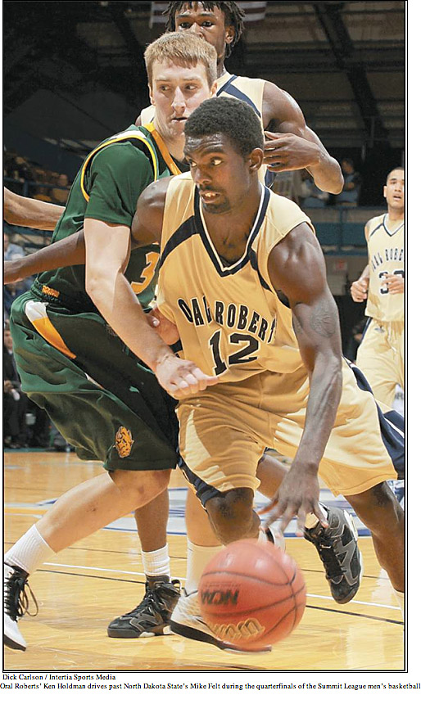
Professional work
Basketball:

Slide 39
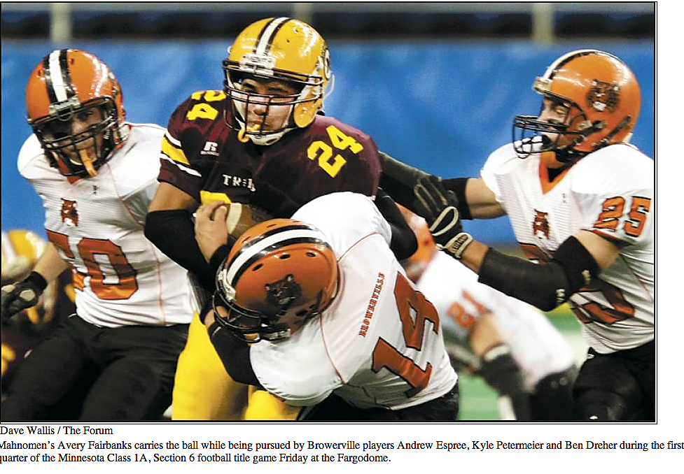
Professional work
Football:

Slide 40
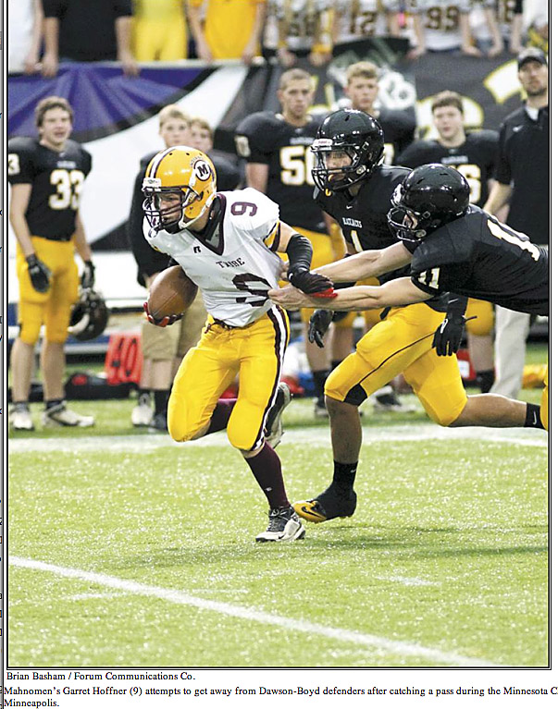
Professional work
Football:

Slide 41
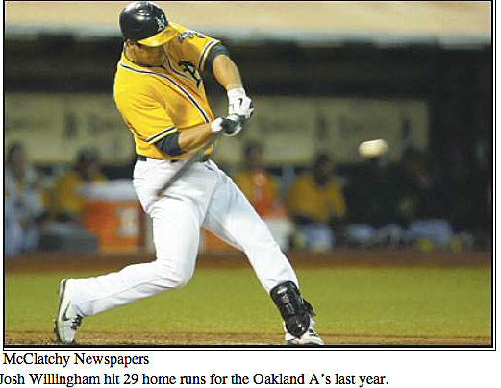
Professional work
Baseball:

Slide 42
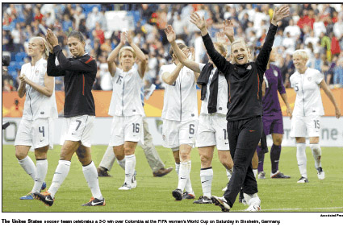
Professional work
Sports feature:

Slide 43
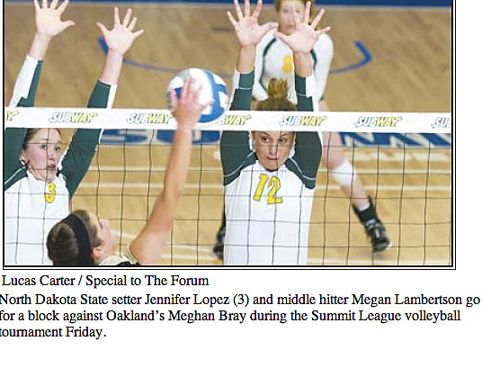
Professional work
Volleyball:

Slide 44
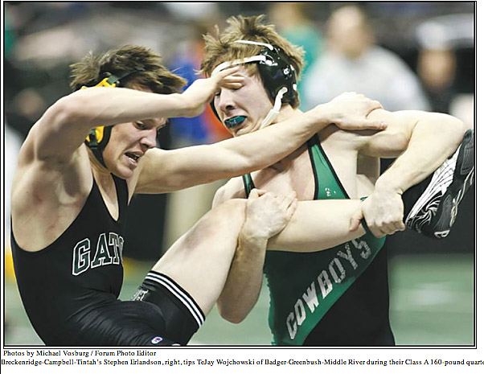
Professional work
Wrestling:

Slide 45
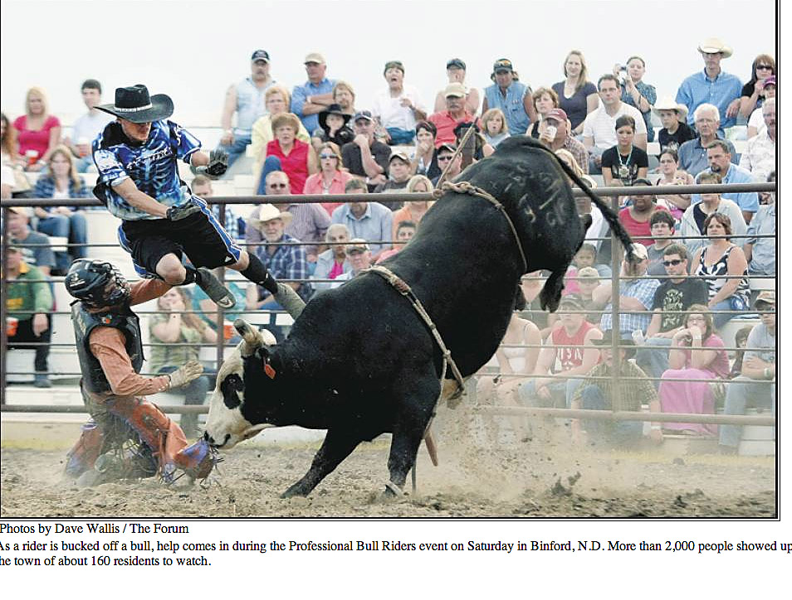
Professional work
Bull riding!:

Slide 46
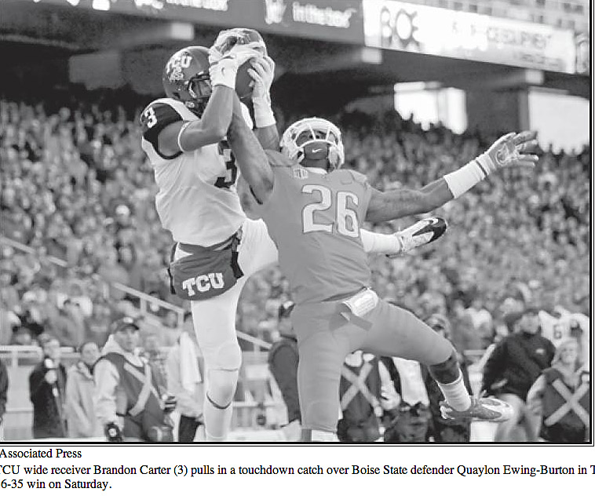
Professional Work
Many sports photos end up published in black and white.

Slide 47
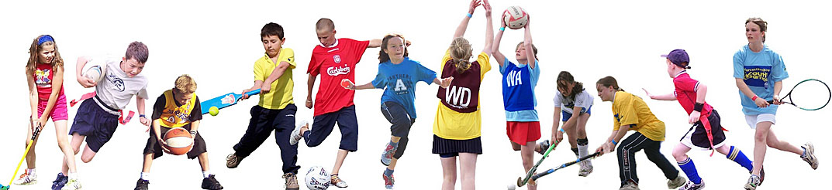
YOur sports
What is your favorite sport, and what tips could you offer to a photographer interested in shooting photos of that sport?

